Slide 1
DOE Meeting 11/06/2024
Streams!!!!

Slide 2
What I am interested in and how it fits in the overarching DOE project

Slide 3
Dissertation Objectives:
Chapter 1: Use long-term, high-frequency data to track spatial and temporal variation (80%).
Chimney (externally sourced) vs Reactor (internally produced) Pathway
Chapter 2: Quantify and estimate riparian corridor carbon fluxes via groundwater carbon samples.
Chapter 3: Longitudinally sample flatwood, headwater streams to track how carbon accumulates downstream.

Slide 4
Maybe a table of everything and progress

Slide 5
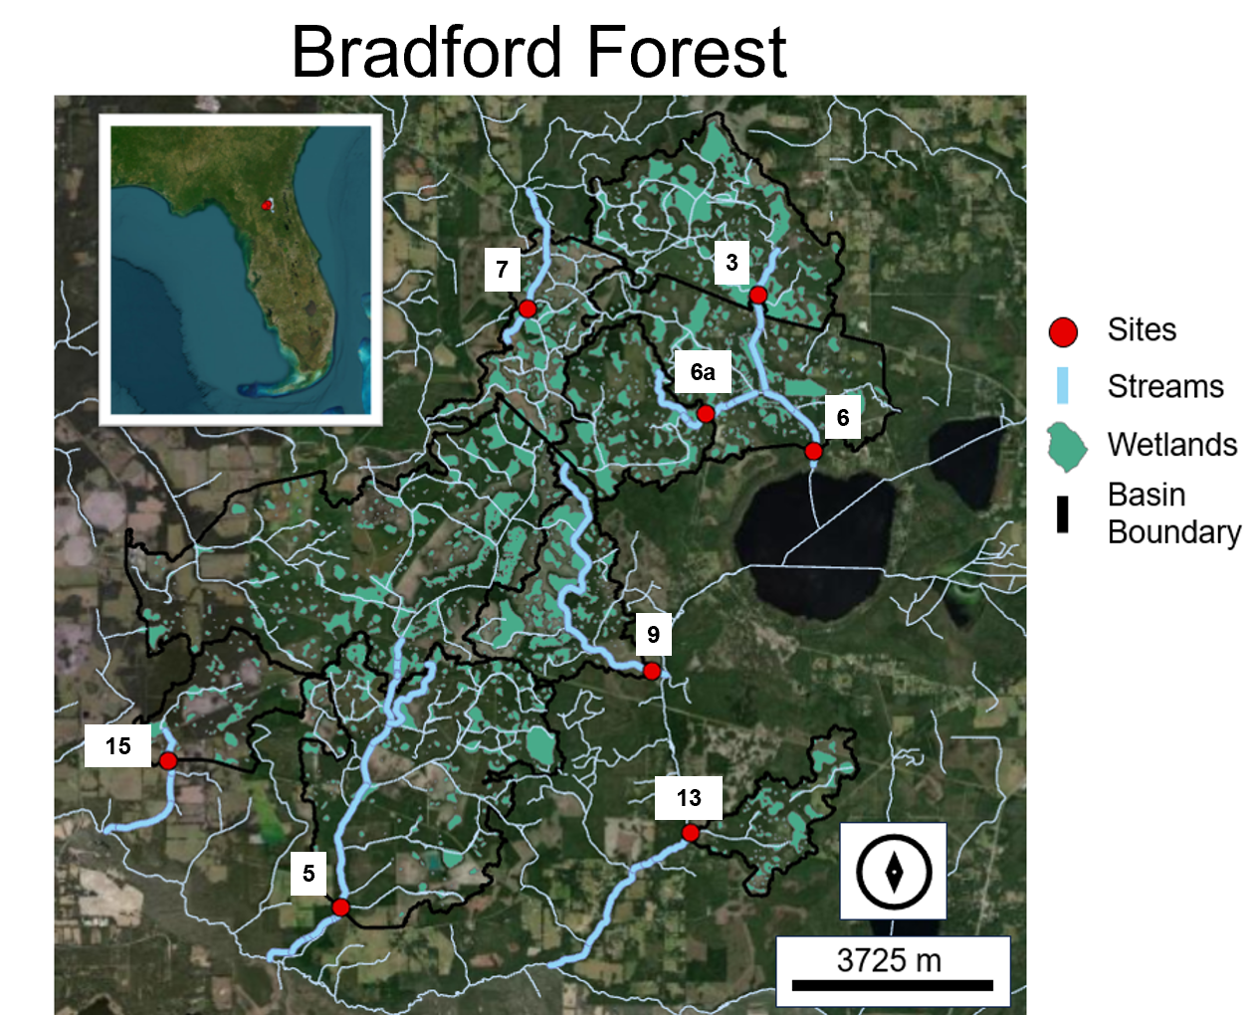

Slide 6
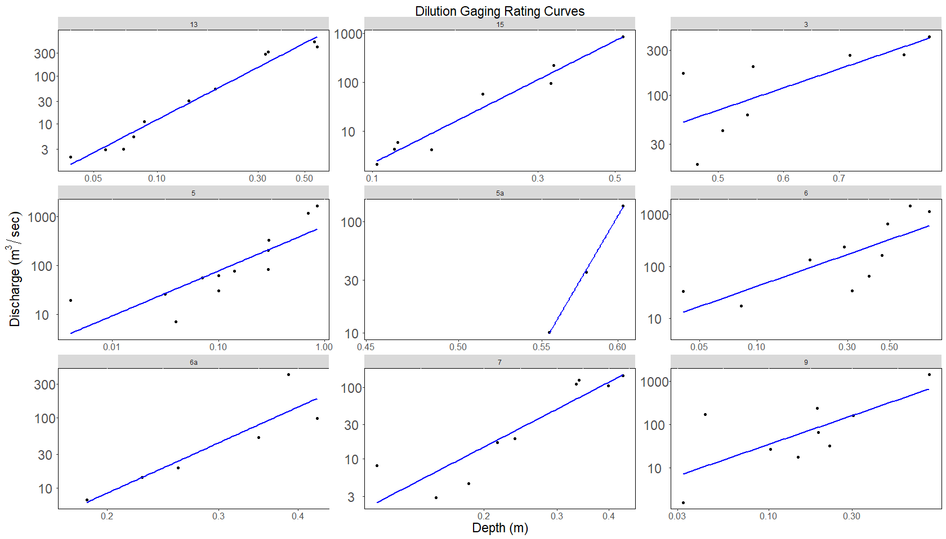
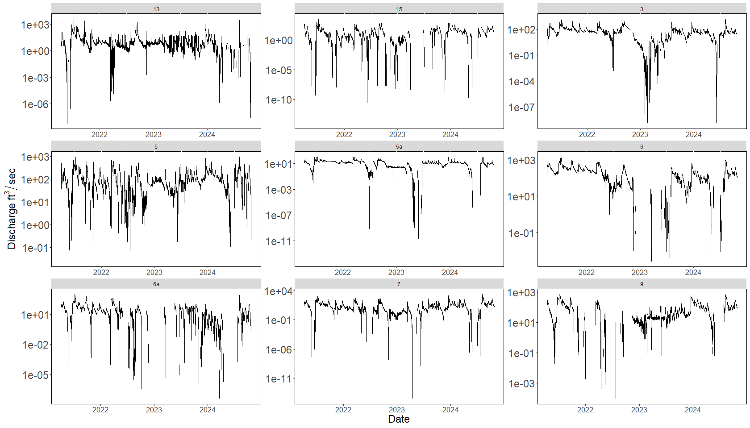
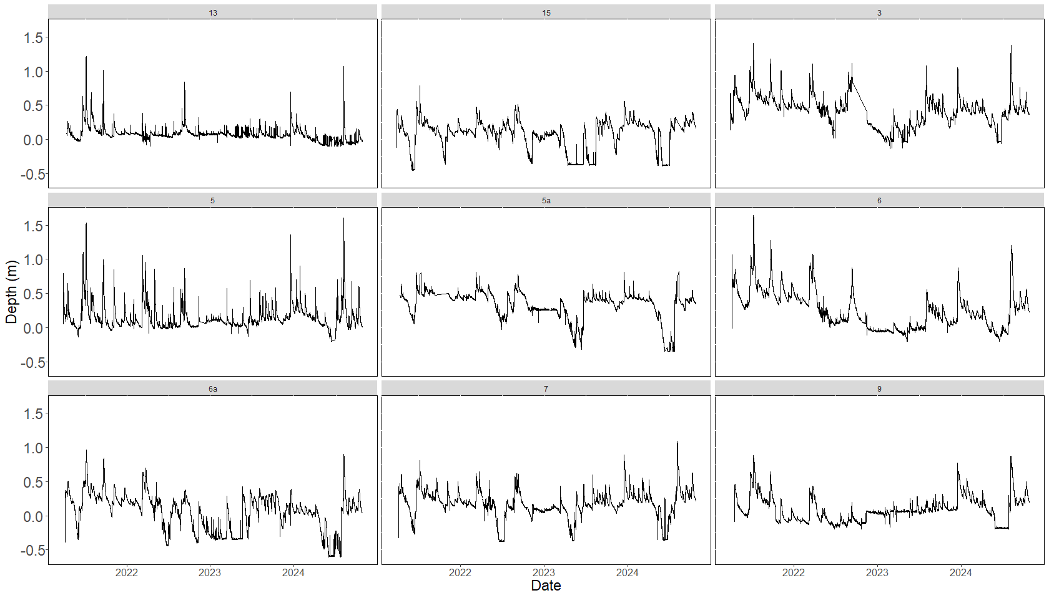

Slide 7
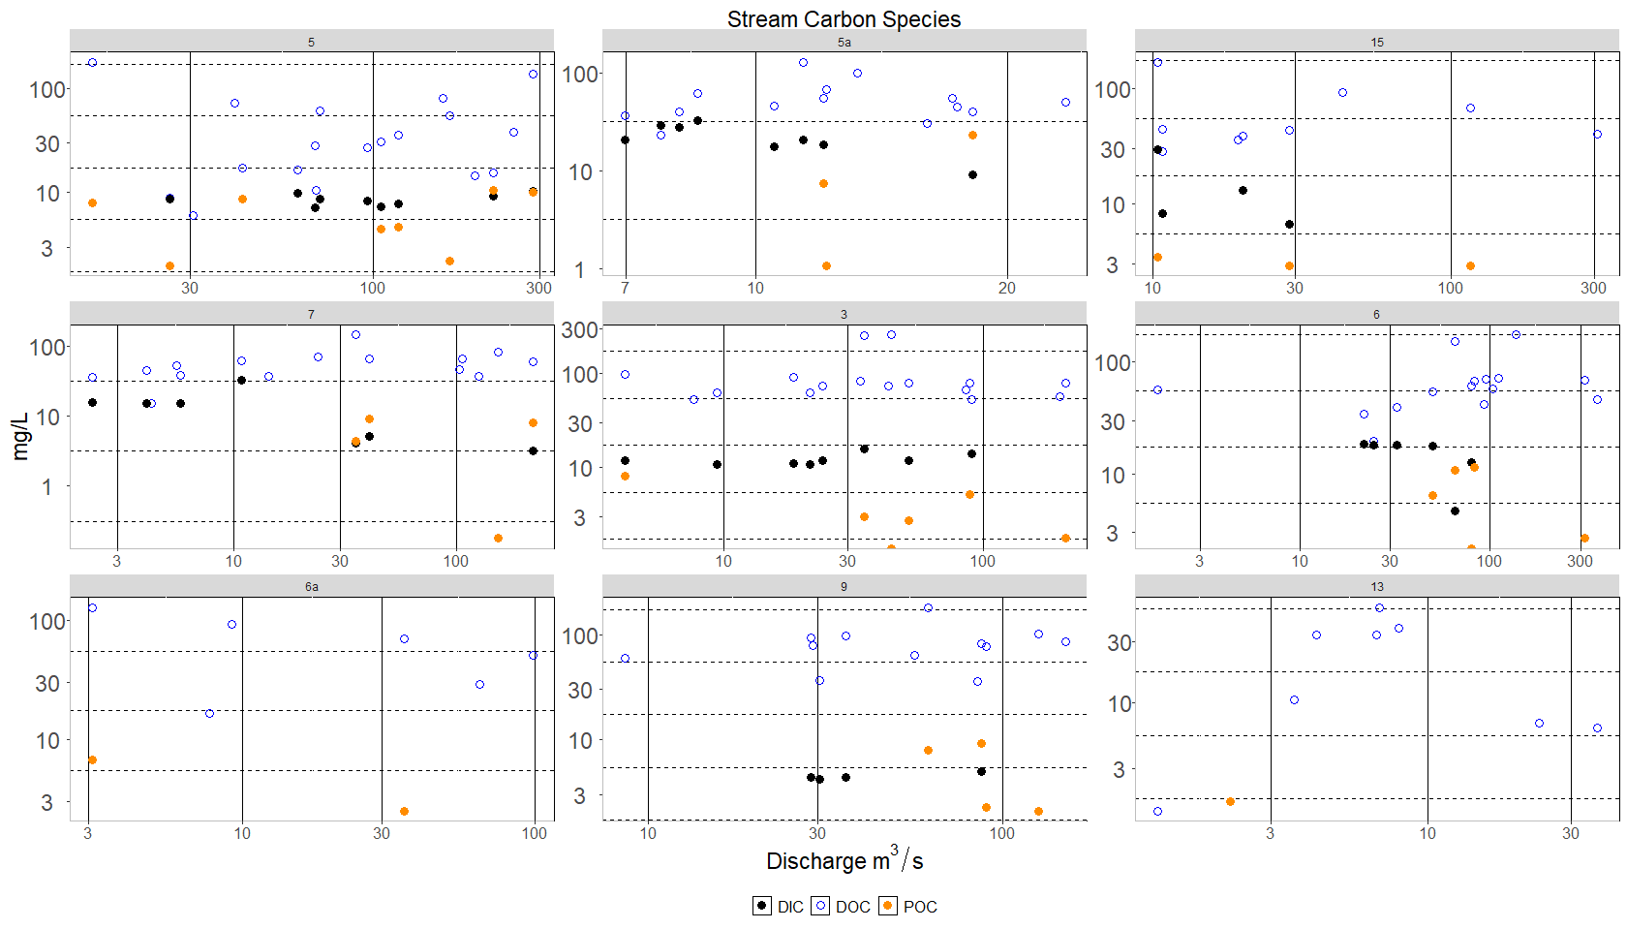

Slide 8
Vachon Graph

Slide 9
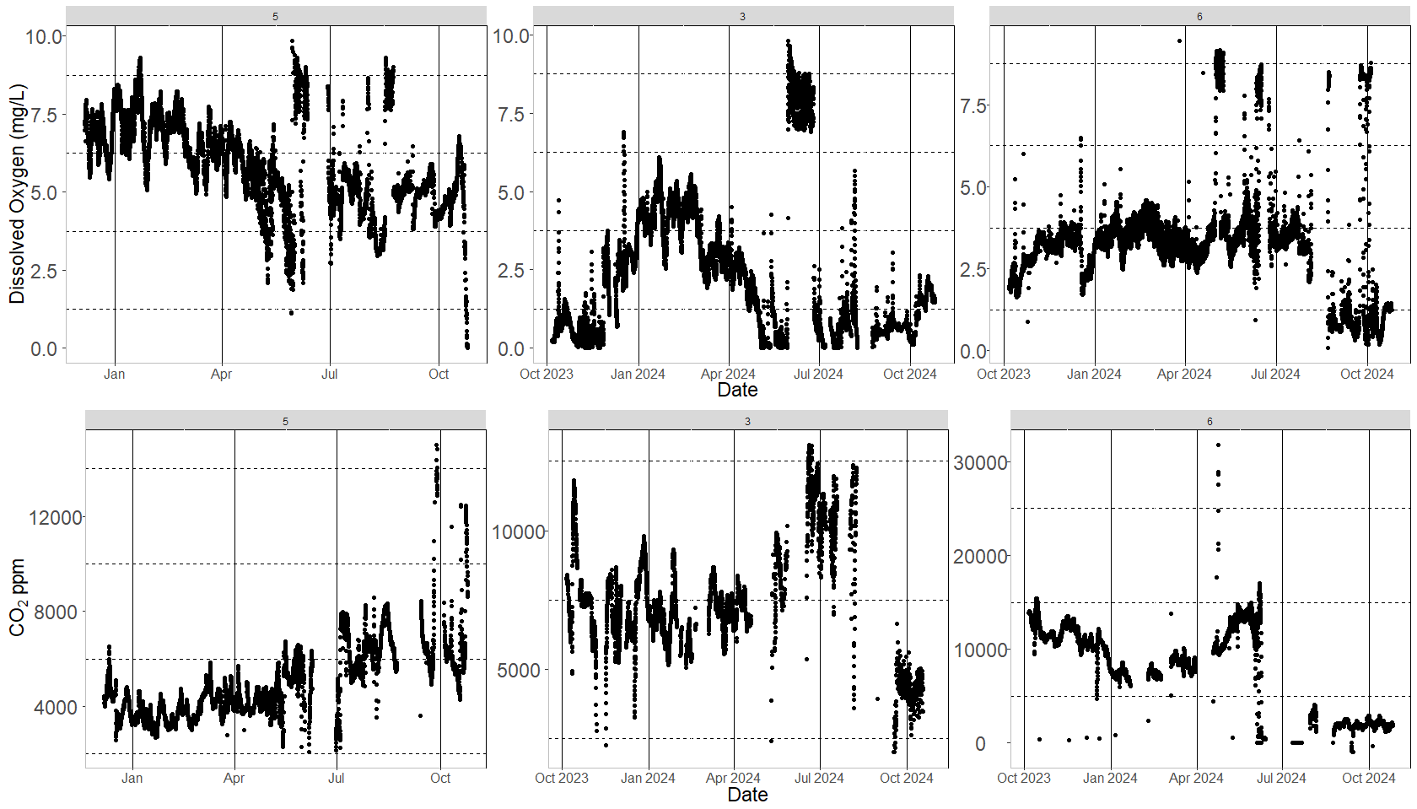
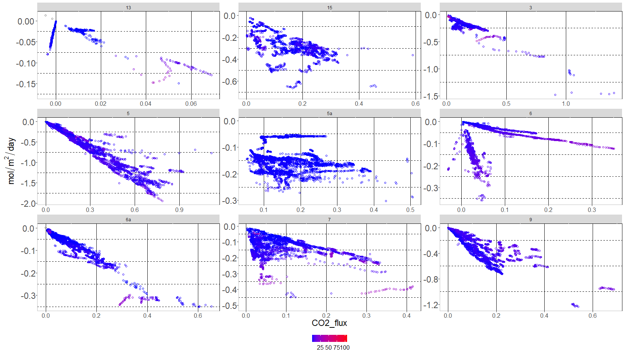

Slide 10
